Slide 1

SALESMAN PORTFOLIO
STUDENT NAME
-
PAVITHRA S
REGISTER NUMBER
-
2426J0361
NM ID
-
B9ECF721E9D83029CB5439CCA6C61DF2
DEPARTMENT
-
DEPARTMENT OF COMPUTER SCIENCE (B.Sc<IT>)
COLLEGE
-
NAVARASAM ARTS AND SCIENCE COLLEGE FOR WOMENS
BHARATHI YAR UNIVERSITY

Slide 2

AGENDA
:
1.PROBLEM STATEMENT
2.PROJECT OVERVIEW
3.END USER
4.TOOLS AND TECHNOLOGY
5.PORTFOLIO DESIGN AND LAYOUT
6.FEATURES AND FUNCTIONALITY
7.RESULTS AND SCREENSHOT
8.CONCLUSION
9.GITHUB LINK

Slide 3

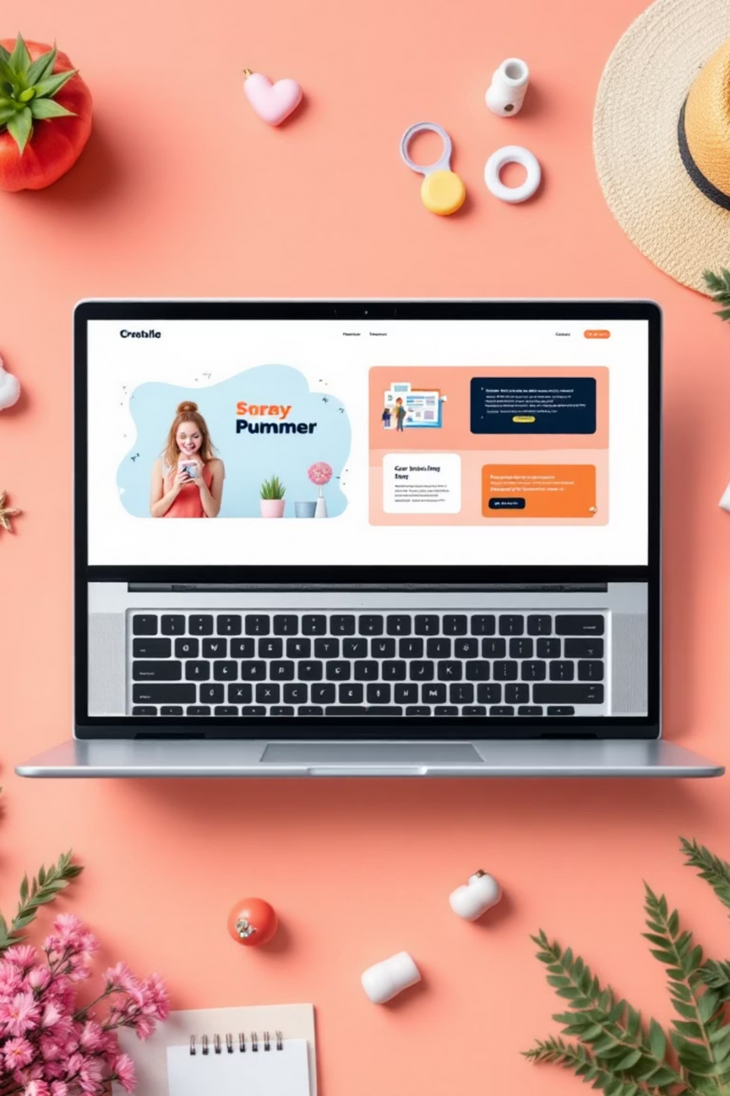
Creating a Professional Portfolio Website: Development Journey
Welcome to our journey through the development of a professional portfolio website. This presentation will cover the entire process, from identifying the core problem to showcasing the final results and future aspirations.
Notes:
1

Slide 4



Problem Statement: Addressing the Need for a Personal Development Showcase
Limited Visibility
Static Resumes
Competitive Market
Many developers struggle to effectively showcase their skills and projects to potential employers.
Traditional resumes often fail to convey the dynamic nature and depth of a developer's work.
A strong, professional online presence is crucial for standing out in today's tech landscape.
Notes:
2

Slide 5
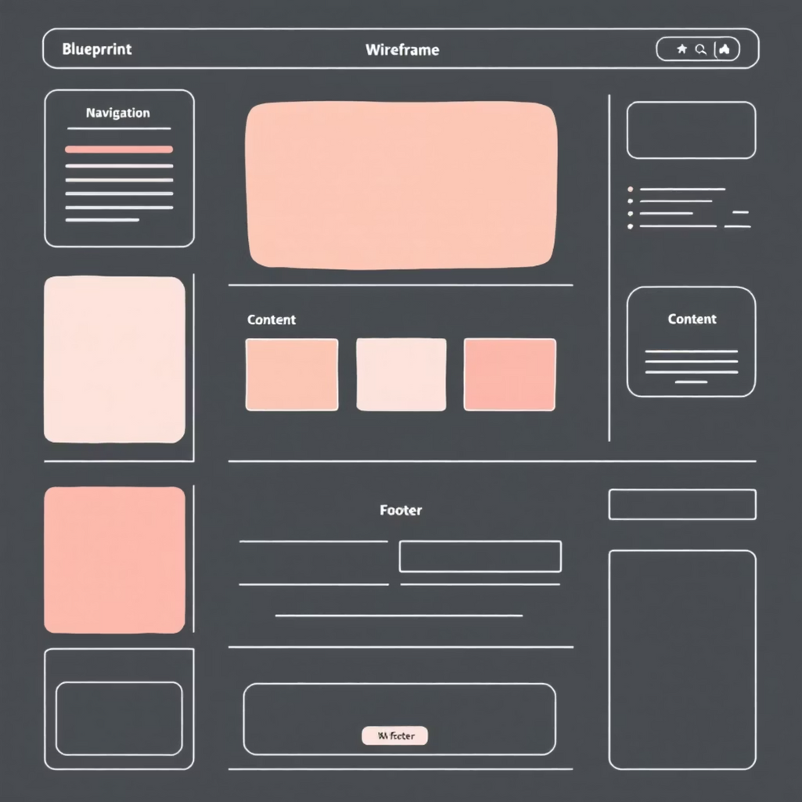
Project Overview: Building a Responsive, Modern Portfolio Website
01
Goal Setting
Define key objectives: showcase projects, highlight skills, provide contact info.
02
Design & Planning
Create wireframes, mockups, and content strategy for a user-centric experience.
03
Development & Testing
Implement front-end code, ensure responsiveness, and rigorously test functionality.
04
Deployment & Maintenance
Launch the site and establish a plan for ongoing updates and improvements.
Notes:
3

Slide 6


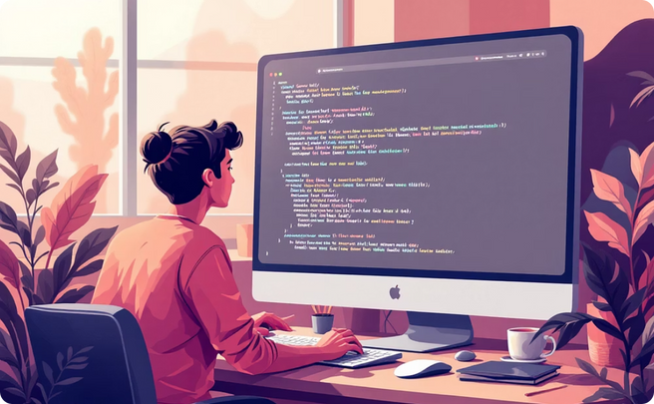
End Users: Recruiters, Employers, and Fellow Developers
Recruiters
Employers
Fellow Developers
Quickly assess skills and project relevance for open positions.
Gain deeper insight into practical application of skills and problem-solving abilities.
Inspire and connect with peers, fostering collaboration and learning.
Understanding our audience was key to tailoring the content and design for maximum impact.
Notes:
4

Slide 7
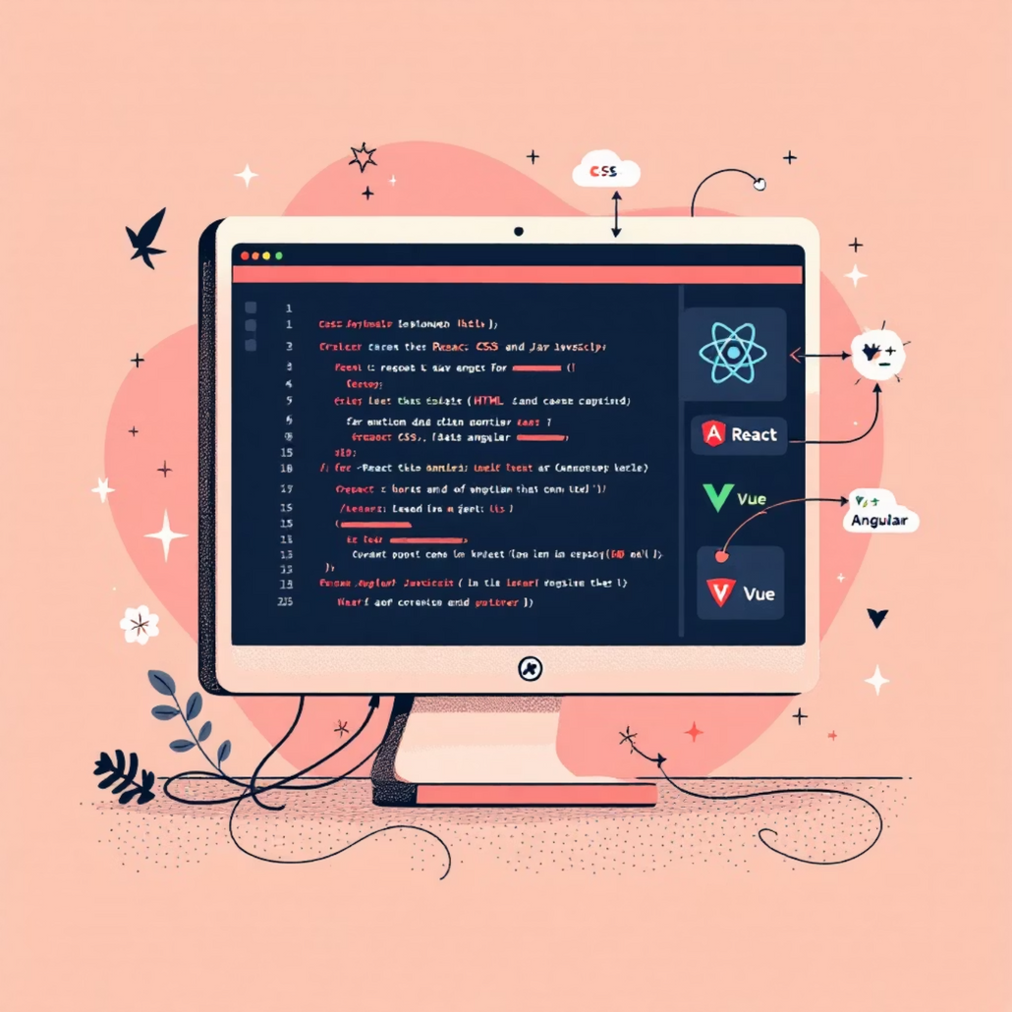
Tools and Technology: The Foundation of Our Portfolio
Our professional portfolio website is built using a robust stack of modern web technologies to ensure performance, responsiveness, and maintainability.
HTML5: Structure
Semantic markup for clear content organization and accessibility.
CSS3: Style & Design
Modern styling, animations, and transitions for a visually appealing interface.
JavaScript: Interactivity
Dynamic content, interactive elements, and a smooth user experience.
Responsive Frameworks: Adaptability
Ensuring seamless display across all devices, from desktops to mobile phones.
Notes:
5

Slide 8
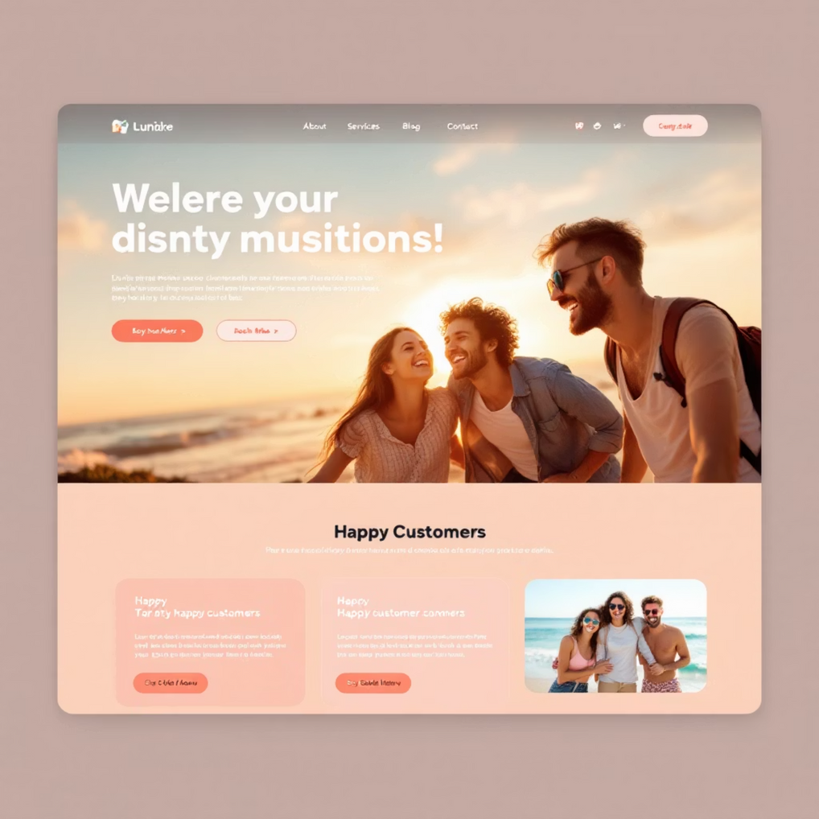
Portfolio Design and Layout: User-Centric Interface with Intuitive Navigation
Clear Hierarchy
Logical structuring of content, guiding users through projects and skills.
Minimalist Aesthetic
Clean lines and ample whitespace to emphasize content and reduce clutter.
Responsive Layouts
Adaptable design that looks great on any screen size or device.
Intuitive Navigation
Easy-to-find menus and clear calls-to-action for seamless browsing.
Notes:
6

Slide 9




Features and Functionality: Dynamic Content Display and Interactive Elements
Project Showcase
Skills Highlight
Detailed descriptions, tech stacks, and live demos for each project.
Interactive display of technical proficiencies and soft skills.
Contact Form
Dark Mode Toggle
Direct communication channel for inquiries and collaboration opportunities.
Enhanced user experience with customizable theme preferences.
Notes:
7

Slide 10
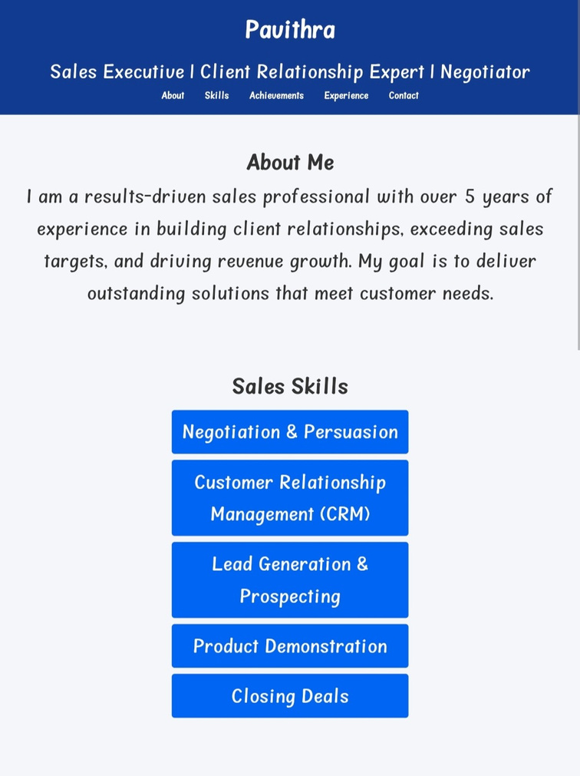
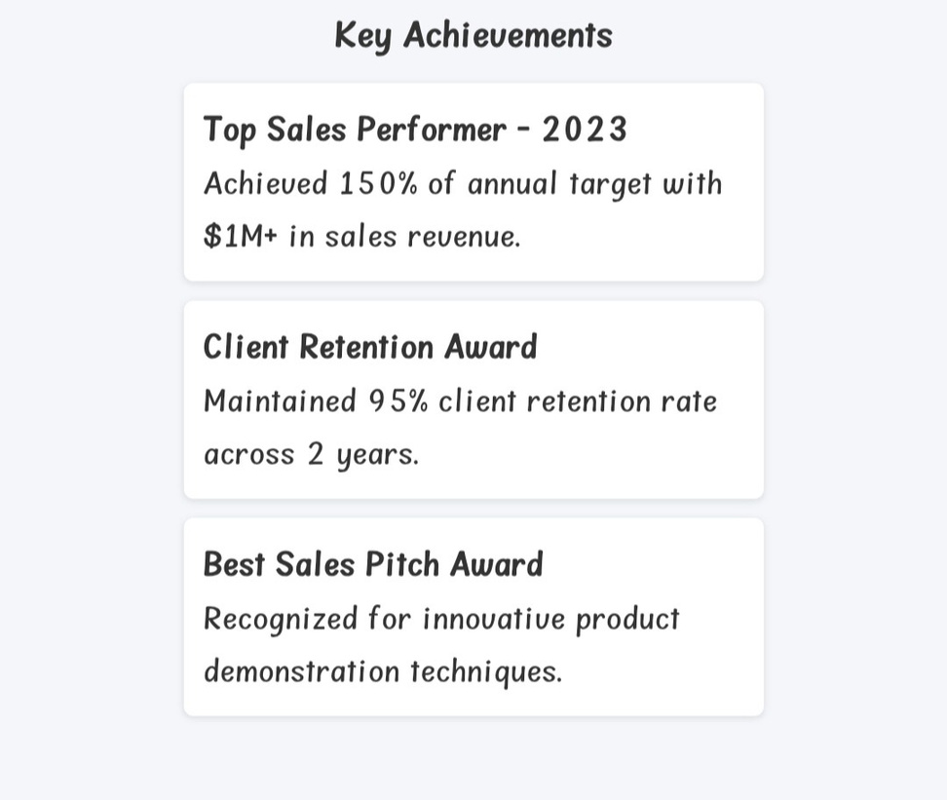
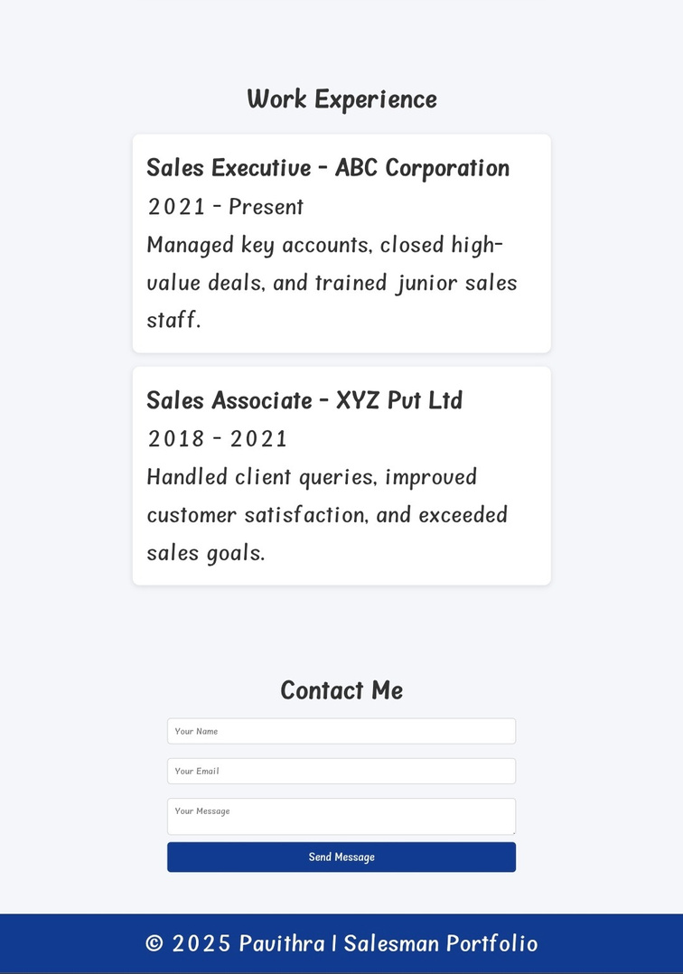
Results and Screenshots: Demonstrating the Final Implementation
Notes:
8

Slide 11
Conclusion: Lessons Learned and Future Enhancements
Key Takeaways
Future Enhancements
1
User-Centric Design: Always prioritize the end-user experience.
Integrate a blog section for sharing insights and articles.
Iterative Development: Embrace continuous improvement based on feedback.
Add an interactive "About Me" section with a timeline of experiences.
2
Explore backend integration for dynamic content management.
3
Visual Storytelling: Showcase projects effectively, don't just list them.
Notes:
9

